Slide 1



UNIT 5: Where I live
Places in my town

Slide 2
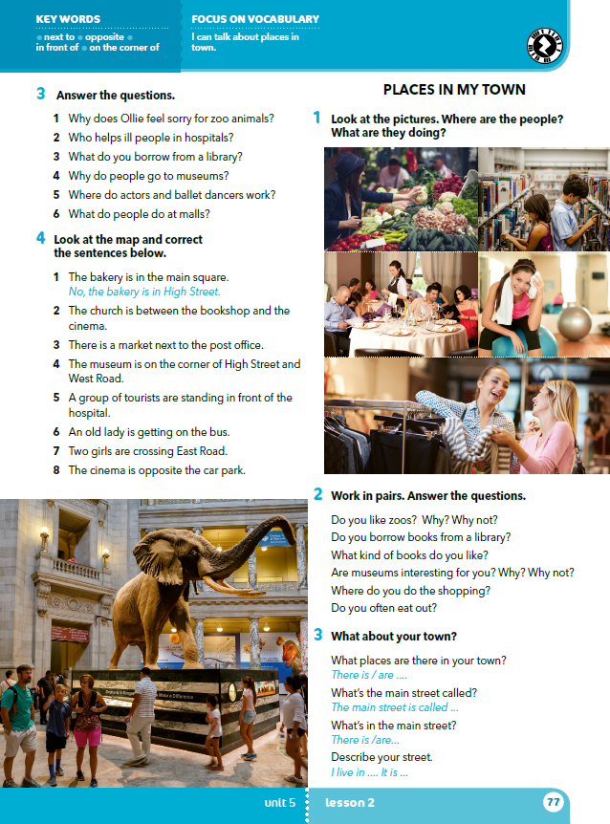

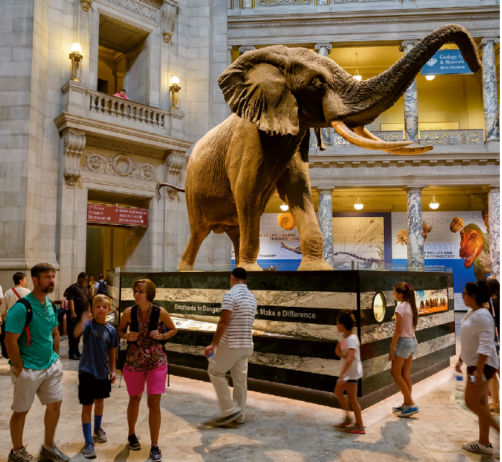
Where are the people?
What are they doing?

Slide 3
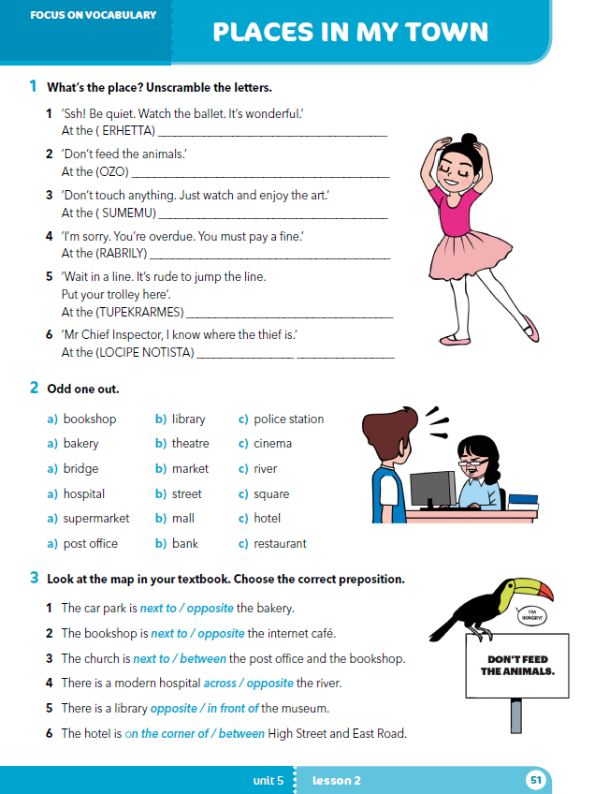
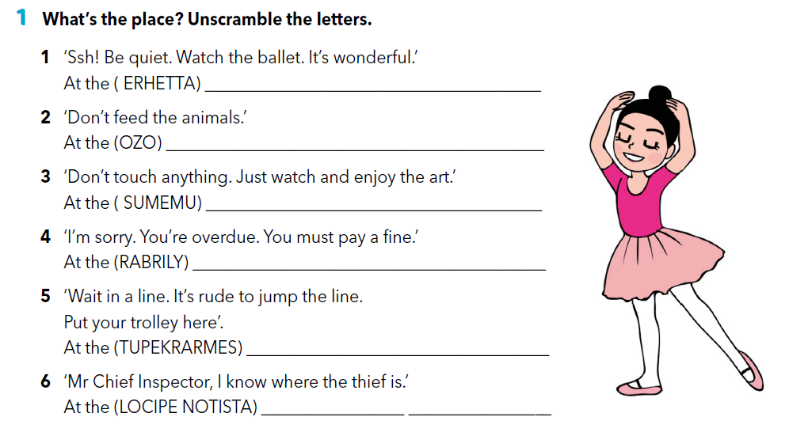
Workbook p 51.
THEATRE
ZOO
MUSEUM
LIBRARY
line = red; trolley - kolica
SUPERMARKET
thief = lopov
POLICE STATION

Slide 4
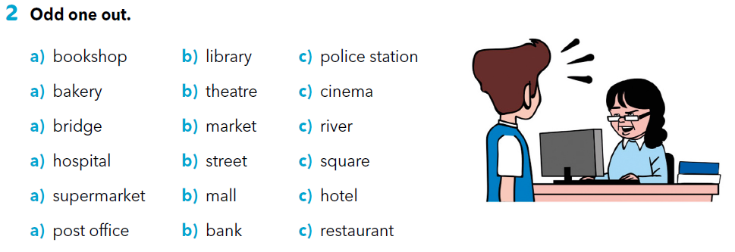

Slide 5
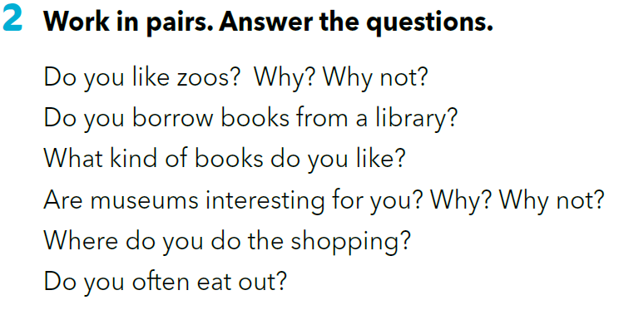

Slide 6
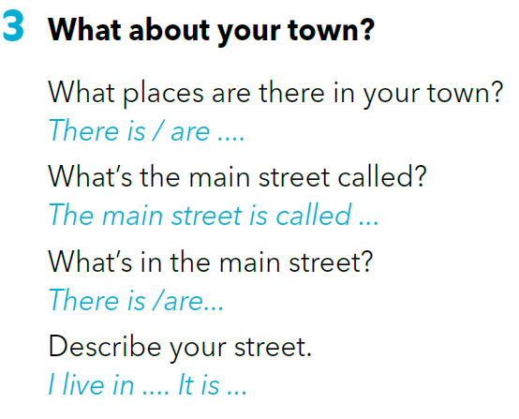

Slide 7
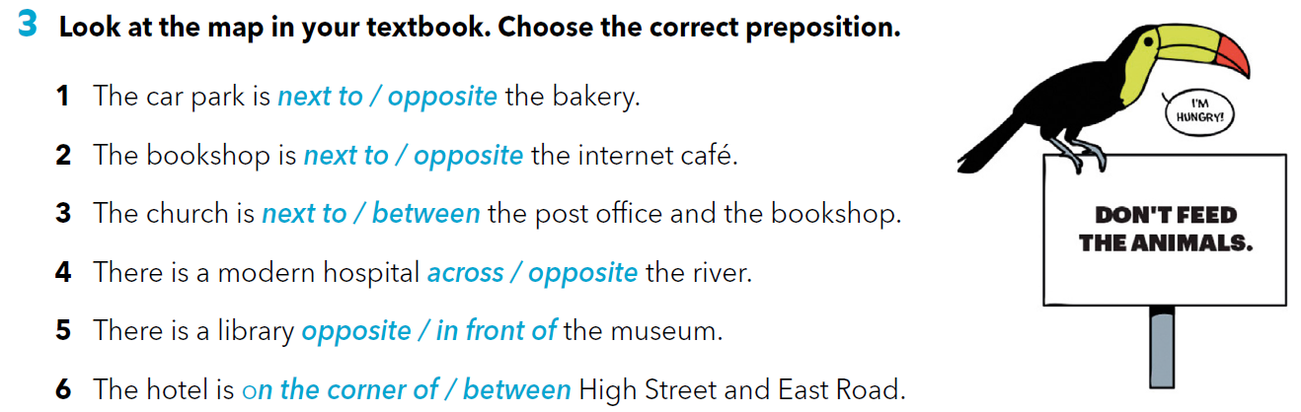
Workbook page 51.

Slide 8

LEARN MORE.
https://www.e-sfera.hr/dodatni-digitalni-sadrzaji/b0be3b2e-c7fc-4dbd-a517-b4839109dc8d/

